Slide 1

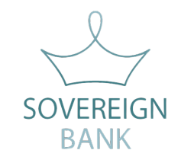
Sovereign Bank Security Architecture & Scoped Applications
Group 7 - NowArchitect
Architect @ServiceWow
ServiceWow

Slide 2
Challenges
Security & Encryption Strategy
Scoped Applications
Key Takeaways & Next Steps
Agenda
Notes:
Speaker Notes: This agenda outlines our discussion today, covering Sovereign Bank’s security challenges, `encryption strategies, scoped applications, key takeaways and next steps.
Today, we’ll discuss how Sovereign Bank can improve its security architecture while ensuring scoped applications meet business needs.
We’ll also cover encryption best practices and compliance strategies.

Slide 3


Current Security Risks & Challenges
Regulatory Compliance
Expertise & Advisory Role
Stability & Risk Mitigation
Encryption vs. Usability
Notes:
Regulatory Compliance → the bank Must align the various regulatory entities, ensuring data residency and encryption standards.
Expertise & Advisory Role → Security decisions must balance platform best practices with Sovereign Bank’s risk demands, requiring clear governance.
Stability & Risk Mitigation → Prevent disruptions from encryption complexities while maintaining system performance and integration stability is extremely important.
Encryption vs. Usability → Secure sensitive data without degrading reporting, searchability, or workflow automation.
Sovereign Bank has strong security concerns due to past on-prem failures. We need an approach that secures data without impacting usability or reporting.

Slide 4

Encryption Strategy
Database Encryption
Full Disk Encryption
Platform Encryption
Edge Encryption
Notes:
To encrypt Personally Identifiable Information and other sensible data
Database – Database encryption encrypts all stored data. We shouldn’t use it because it affects the performance of the platform
Platform encryption (PE) provides field and attachment-based data encryption within instances of the Now Platform.
Full Disk Encryption (FDE) protects all data on a storage device by encrypting it at the hardware or software level
Edge encryption - Edge Encryption encrypts data before it reaches the ServiceNow cloud, ensuring that only encrypted data is stored in the platform.
To reduce disruption, we recommend Field-Level Encryption. This ensures compliance with data privacy laws while allowing reporting and integrations to function smoothly.

Slide 5
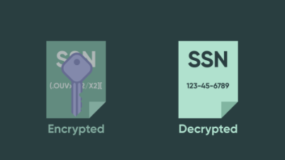
Platform Encryption
Encryption of supported field types of string, date/time, and URLs
Offers both deterministic and non-deterministic encryption options
Offers several access controls based on role assignment and application scope
Notes:
With PE, users can configure which specific data to encrypt within a specific table.
The data is then stored in encrypted form.
Encryption keys are stored and maintained within the ServiceNow instance and managed through the key management framework.

Slide 6

Full Disk Encryption
Protects against physical loss
Self-encrypting AES-128 storage devices
Secures all stored data
Notes:
Why It’s Not Ideal for Sovereign Bank, but we still recommend it?
🚫 FDE is too broad—it encrypts everything, making integration and reporting a bit difficult.
While it might not be the most obvious solution for the bank, we still think its extremely important to keep all Bank information fully secure.

Slide 7
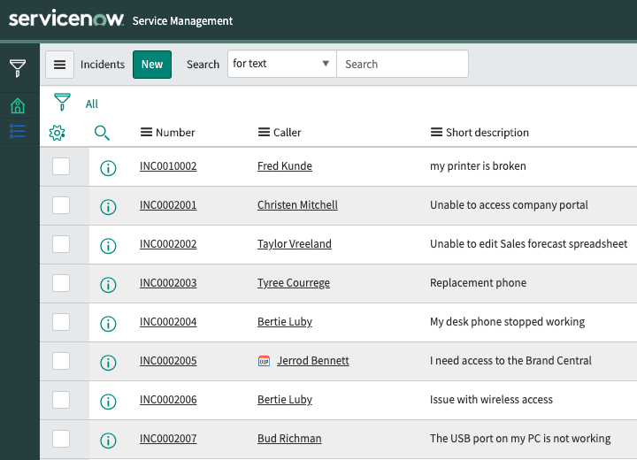
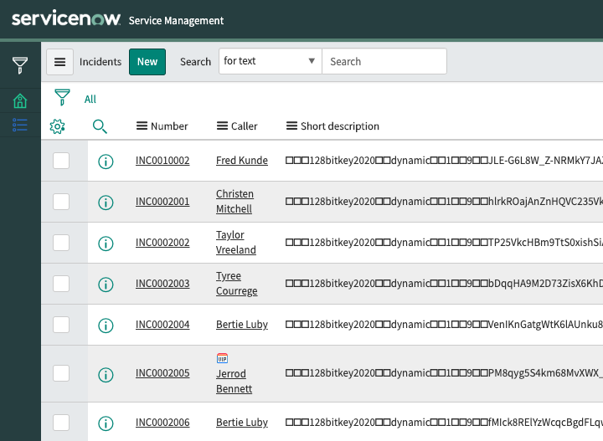




How regulatory compliance is assured? - Edge Encryption
TLS
TLS 1.2
RSA Signature
Encryption Key
End Users
Encryption Proxy
ServiceNow Cloud
What you see through the proxy
What is stored in ServiceNow
Notes:
This image illustrates how regulatory compliance is assured using Edge Encryption in ServiceNow by encrypting data before it reaches the cloud.
Breakdown of the Diagram:
End Users:
Users interact with the system through a browser or application.
The connection is secured using TLS 1.2 encryption to protect data in transit.
Encryption Proxy:
Acts as an intermediary between the end users and the ServiceNow cloud.
Encrypts data before it is sent to ServiceNow.
Manages encryption keys to ensure security and compliance.
ServiceNow Cloud:
Stores only encrypted data, meaning ServiceNow cannot see the unencrypted information.
Uses TLS encryption for data transmission security.
Implements RSA signatures to ensure the authenticity and integrity of data exchanges.
Key Takeaways:
✅ Data is encrypted before it reaches ServiceNow, ensuring that even ServiceNow cannot access plaintext data. ✅ TLS encryption protects communication between users, the proxy, and the cloud. ✅ Encryption Proxy manages keys, allowing organizations to retain full control over data security. ✅ Regulatory compliance is assured because sensitive information is never exposed in the cloud.
This model is useful for highly regulated industries like banking and healthcare, where data privacy laws require strict control over sensitive information.
ALSO TALK ABOUT HOW EACH FIELD WILL BE ENCRYPTED DEPENDING ON COUNTRY OF ORIGIN

Slide 8

Scoped Applications – Development Strategy
Use Scoped Applications for Custom Development
Keep Business Logic Modular
Version-Controlled Releases
Least Privilege Model
Notes:
What are scoped applications and why do we need them?
There are two types of available application scopes: private application scope) and global scope.
Each ServiceNow application has an application scope that determines which of its resources are available to other parts of the system.
Application scoping ensures that one application does not impact another application.
Best Practices for Scoped Apps
✔ Use Scoped Applications for Custom Development → Prevent unwanted platform-wide access. ✔ Keep Business Logic Modular → Allow easy upgrades without breaking dependencies. ✔ Version-Controlled Releases → Reduce risks in deployments. ✔ Least Privilege Model → Grant only necessary access rights.
Scoped applications improve security and upgradeability. By following these best practices, Sovereign Bank can standardize app development and minimize risks.
In order to successfully implement a scoped application, there is some steps, or so called migration strategy that we should adopt.

Slide 9
Scoped Applications – Migration Strategy
Build
Share
Build the application
Application Repository
Step 2
Step 4
Step 1
Step 3
Requirements
Test
Understand business requirements
Test the application
Notes:
This phased approach ensures a smooth transition while keeping security at the core of the implementation
1. Understand business requirements
2. Build the application
3. Test the application
4. Share the application ➔ Application Repository

Slide 10
Security Best Practices for Sovereign Bank - Scoped application
Monitor with Security Incident Response (SIR)
Enforce Multi-Factor Authentication
Use Encrypted Data Stores
Regular Security Audits
Notes:
There are a few points, regarding security, that we should be aware while developing a scoped application
Enforce Multi-Factor Authentication (MFA) → Prevent unauthorized access (this will be mandatory in 2026) Use Encrypted Data Stores → Secure customer and employee data at rest. Monitor with Security Incident Response (SIR) → Detect and respond to threats. Regular Security Audits → Ensure ongoing compliance.
These security measures will strengthen Sovereign Bank’s defenses while maintaining system performance.

Slide 11

Key Takeaways
Encryption
Scoped Applications
Security Best Practices
Notes:
Main Points to Remember:
Edge encrypt ensures security while maintaining integration capabilities and Full Disk Encryption secures all stored data, including the most sensitive data. Scoped Applications improve security, standardization, and ease of upgrades. Security Best Practices like MFA, monitoring, and audits protect the platform.
These key takeaways summarize our approach to security and scoped applications. By following these principles, Sovereign Bank can achieve a secure and scalable ServiceNow implementation

Slide 12
Next Steps
Secure Data Without Disrupting Operations
Develop & Migrate Scoped Applications Securely
Standardize Security Across the Enterprise
Notes:
✅ Secure Data Without Disrupting Operations with Edge encrypt minimizing the whole impact of it. ✅ Develop & Migrate Scoped Applications Securely to Protect data integrity & compliance. ✅ Standardize Security Across the Enterprise by Implement access control, MFA, and audits.
Sovereign Bank can achieve a secure, compliant, and scalable platform by implementing these strategies.

Slide 13




Thank you
www.servicewow-consultancy.com
Notes:
Thank you for your time, together, we can make Sovereign bank data safer than ever!

